Slide 1
Welcome

Slide 2
Presented By :
Md. Abu Taher
Senior Teaher
Gazirhat High School
Senbag , Noakhali .
Mobile No : OI718254597

Slide 3
Presented for Whom :
Class : Six
Subject : English 1st paper
Writing Test
Paragraph Writing
Date: 08/10/2016

Slide 4
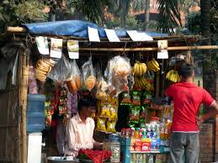
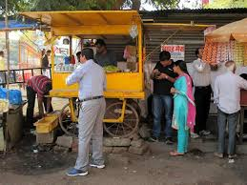
Let’s see the pictures
Have you seen these pictures ?
Are you familiar with these pictures ?

Slide 5
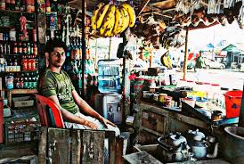
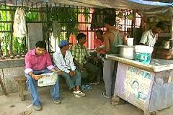
What is this ?
Where is it seen ?

Slide 6
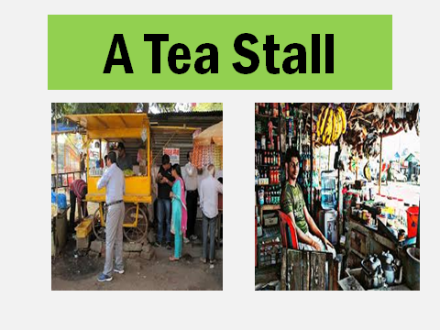
Now let’s discuss about …..

Slide 7
Learning Outcomes
By the end of the lesson student will be able to
a) describe about tea stall
b) develop writing skill
c) develop creativity
d) tell about a tea stall .

Slide 8
Before writing the paragraph you have to think over the questions
a) What is a tea stall ?
b) Where is it seen ?
c) When does it open and close?
d) How is a tea stall furnished ?
e) What do people do there ?
f) How does a tea stall become
a meeting place ?s

Slide 9
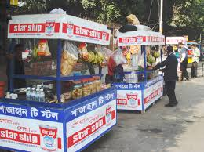
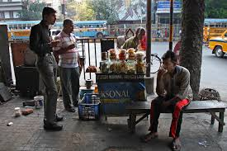
What is a tea stall ?
Tea is a popular hot drink. So a tea stall
is a common place to all classes of
people . A tea stall is a small shop
where tea is prepared and sold.

Slide 10
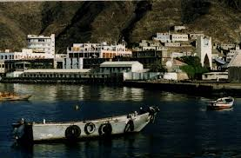
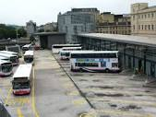
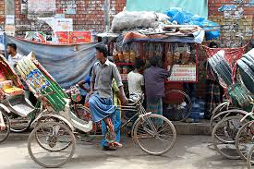
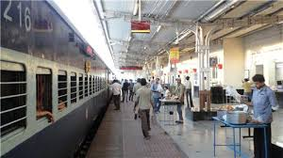

Slide 11
Individual Work
Where is it seen ?
Generally a tea stall is seen in
the village market , rail station ,
bus station or other crowded
place where people generally
gathered together.

Slide 12
How is a tea
Stall furnished ?
A tea stall is not well furnished. Some tea stall has no chairs but a few benches.

Slide 13
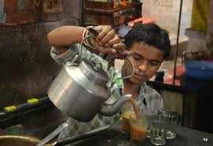
Who works and serve tea?
The owner himself make tea and serve to the customers. Thus he works as a boy and a cashier. Sometimes he engages a boy or two to help him.

Slide 14
What is sold in a tea stall ?
Besides tea, biscuits, bread, bananas betel leaf are also available here .

Slide 15
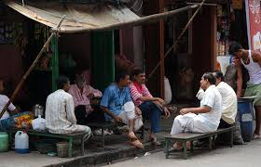
What kinds of people
gather there?
What do they do there ?
It is a meeting place to all classes of people. They gather here and refresh themselves with a cup of hot tea. Sometimes they discuss and debate with political and current affairs. Thus it becomes a mini parliament.

Slide 16
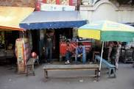
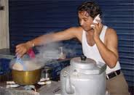
When does it open and closes ?
It opens early in the morning and closes late at night. Thus it remain busy whole day.

Slide 17
The utility of a tea stall cannot be ignored in our society. It plays an important role to solve our unemployment problem .

Slide 18
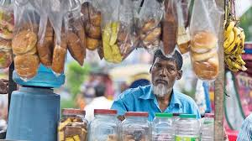
Group Work
a) What is a tea stall?
b) What things are
sold there ?
c) How can it play a
role to solve our
unemployment
problem?

Slide 19
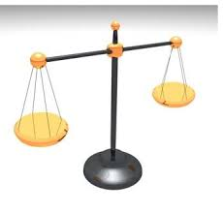
Evaluation
a) Who serve tea in a tea stall ?
b) When does it open and close?
c) Where is it seen ?

Slide 20
Write a paragraph about a tea stall.

